Slide 1


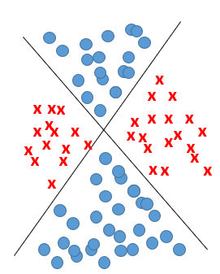
Multilayer Neural Network
non linearly separable problem
2023/2024
Abdelwahab Naji - Enseignant chercheur
Abdelwahab.naji@gmail.com
ENSAO, Université Mohamed premier - Oujda
https://www.youtube.com/c/AbdelwahabNaji

Slide 2
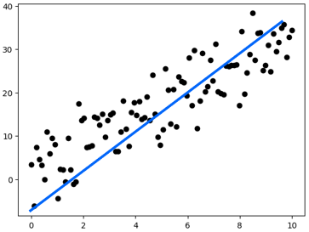
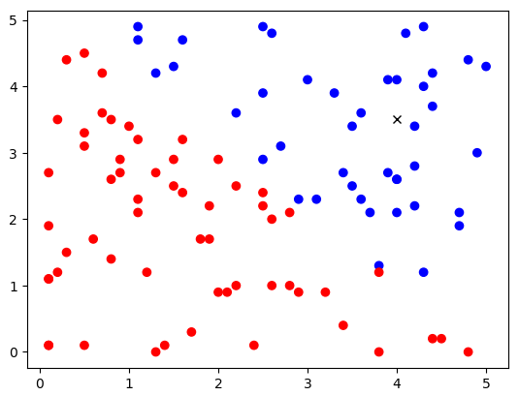
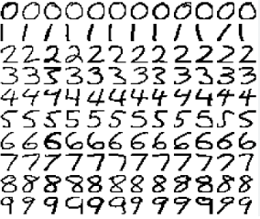
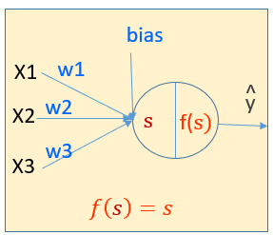
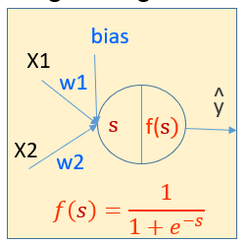
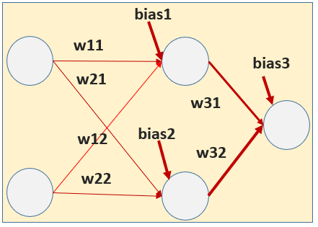
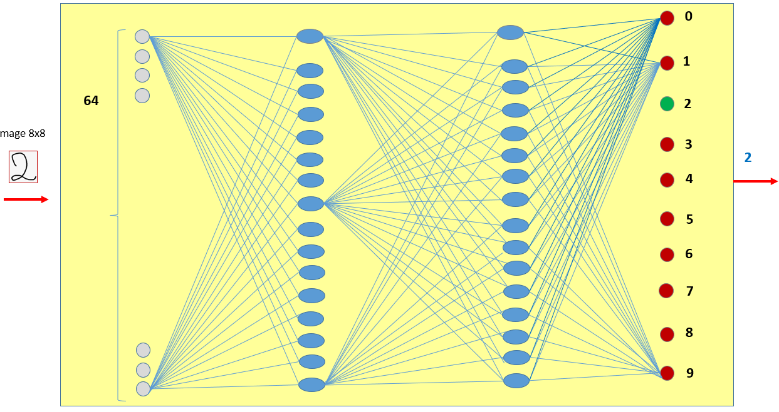
Neural Network for Supervised Learning
3
4
5
1
2
Multi Variate Linear Regression Problem
Linearly Separable problem
Non Linearly Separable problem:
Complex classification problem
Simple Linear Regression Problem
TV | Radio | Np | CA
230.1 | 37.8 | 69.2 | 22,1
44.5 | 39.3 | 45.1 | 10,4
17.2 | 45.9 | 69.3 | 9,3
…
199.8 | 2.6 | 21.2 | 10,6
Random point cloud
Advertising problem
Red or Blue?
XOR Problem
Hand Written digits Problem

Slide 3
Neural Network – One Neurone
Simple Regression Problem
bias
w1
output
X1
ws=bias+w1*X1
linear(z)=z

Slide 4
Neural Network – One Neurone
Simple Classification Problem
bias
w1
output
X1
ws=bias+w1*X1+w2.x2
sigmoid(z)=1/1+exp(-z)
w2
X1

Slide 5
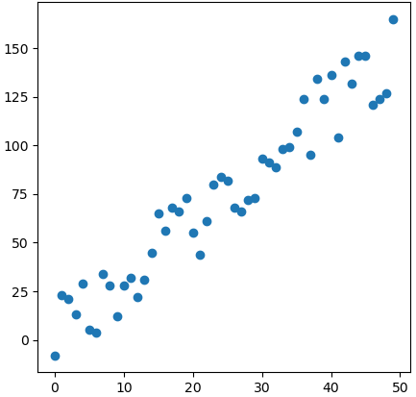
1
Simple Regression problem
plt.figure(figsize=(5, 5))
plt.scatter(X, y)
plt.show()
#Librairies
import matplotlib.pyplot as plt
from random import seed
from random import randrange
import numpy as np
np.random.seed(0)
def f(X):
return 1+3*X
def generateData (n):
X=np.array([i for i in range(n)])
y_model=f(X)
y =np.array([i+randrange(-20,20) for i in y_model])
return X,y_model,y
n_samples = 50
X,y_model,y=generateData(n_samples)

Slide 6
X1

Slide 7
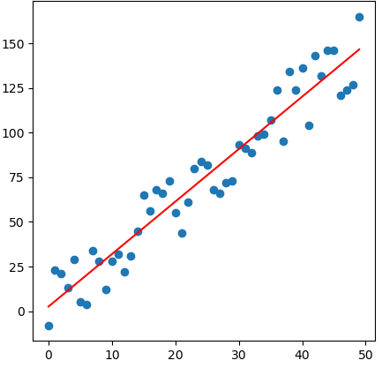
def fit(X,y):
lr=0.001
epochs=10000
bias=0.5
w1=0.5
n=len(y)
for i in range(epochs):
py=bias+w1*X
dbias=-(2/n)*sum(y-py)
print(epochs,"----------------->",w1," , ",bias)
dw1=-(2/n)*sum(X*(y-py))
w1=w1-dw1*lr
bias=bias-dbias*lr
return bias,w1
bias,w1=fit(X, y)
def predict(X):
return bias+w1*X
predicted_y=predict(X)
plt.figure(figsize=(5, 5))
plt.title("Simple Regression Model)", size=16)
plt.scatter(X, y)
plt.plot(X, predicted_y, c="red")
plt.show()

Slide 8
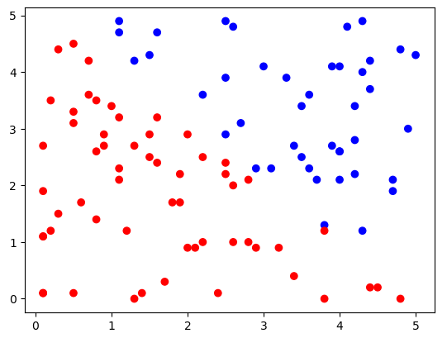
import matplotlib.pyplot as plt
import numpy as np
import matplotlib.colors as clr
2
Simple classification problem Linearly Separable
def f(x):
return -x+5
L=generateData(100)
L=np.array(L)
X=L[:,0]
y=L[:,1]
C=L[:,2]
# generate random floating point values
from random import seed
from random import random
# seed random number generator
def generateData(n):
seed(1)
min=0
max=5
# generate random numbers between 0-1
L=[]
for _ in range(n):
valueX = random()
scaledvalueX = min + (valueX * (max - min))
valueY = random()
scaledvalueY = min + (valueY * (max - min))
x=round(scaledvalueX,1)
y=round(scaledvalueY,1)
y0=f(x)
cl=0
if(y>y0):
cl=1
L.append([x,y,cl])
return L
colors = ['red','blue']
plt.scatter(L[:,0],L[:,1],c=L[:,2],cmap=clr.ListedColormap(colors))

Slide 9
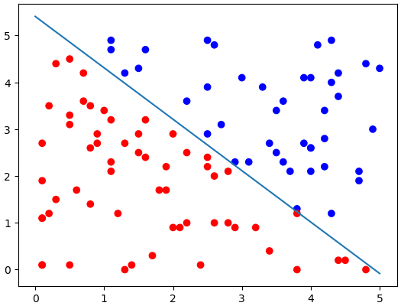
def fit(X,y):
#initialisation
n=len(y)
bias=0.5
w1=0.5
w2=0.5
epochs=5000#hyperparamter
lr=0.01 #hyperparameter
#learning
for i in range(epochs):
y=L[:,2]
ws=bias+w1*L[:,0]+w2*L[:,1]
py=sigmoid(ws)
#update
dbias=-(2/n)*sum(y-py)
dw1=-(2/n)*sum(L[:,0]*(y-py))
dw2=-(2/n)*sum(L[:,1]*(y-py))
bias=bias-dbias*lr
w1=w1-dw1*lr
w2=w2-dw2*lr
return bias,w1,w2
def getY(x,bias,w1,w2):
return -w1/w2*x-bias/w2
x1=0
x2=5
y1=getY(x1,bias,w1,w2)
y2=getY(x2,bias,w1,w2)
colors = ['red','blue']
plt.scatter(L[:,0],L[:,1],c=L[:,2],cmap=clr.ListedColormap(colors))
#plt.plot([x1,x2],[y1,y2])
plt.plot([x1,x2],[y1,y2])
bias,w1,w2=fit(X,y)

Slide 10
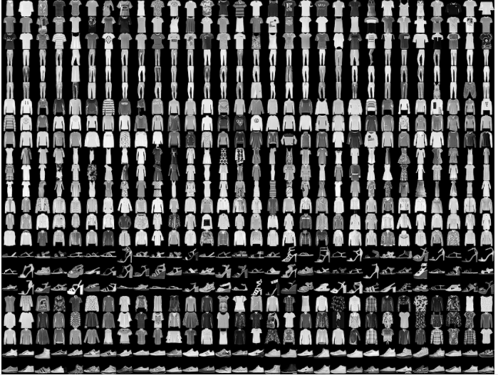
3
4
Complex classification problem non Linearly Separable
Images classification
X2
X1

Slide 11
Mise en œuvre de Neural Network
NN: Multi – Layer
Présentation du problème non linéairement séparable
Implémentation du Problème non linéairement séparable (avec tensorflow, keras )
Exemple 1: simple XOR problem
Générer les données
Créer et entrainer un multilayer neuralnetwork
Exemple 2: general XOR problem
Générer les données
Créer et entrainer un multilayer neuralnetwork
Exemple 3: fashion classification problem
Exemple 4: hand written digits classification problem
Implémentation from scratch
Exemple: fashion classification problem

Slide 12
Problem
Séparation de AND, OR,NAND, NOR, XOR

Slide 13
F | T
F | T
F | F
On peut avoir une séparation linéaire
T
1
And
F
x1
AND
0
output
0
1
x2
On peut avoir une séparation linéaire
F | T
T | T
F | T
T
1
OR
x1
F
OR
0
output
x2
0
1
F | T
T | F
F | T
T
1
On ne peut pas avoir une séparation linéaire
XOR
F
0
0
1

Slide 14
Séparation de X0R
F | T
T | F
F | T
T
1
On peut utiliser plus qu’une ligne pour faire la séparation
XOR
F
0
0
1
1
0
0
1
XOR = (!AND) and (OR)

Slide 15
XOR = (!AND) and (OR)
x1
T
F
T
F
F
! AND
T
! AND
T
! AND
T
! AND
x2
T
F
F
T
x1
T
F
T
F
T
OR
F
OR
T
OR
T
OR
x2
T
F
F
T
x1
F
F
T
T
T
F
XOR
F
T
XOR
XOR
XOR
x2
T
T
F
F

Slide 16
x1
F
F
T
T
T
F
XOR
F
T
XOR
XOR
XOR
x2
T
T
F
F
T
! AND
F
! AND
T
T
! AND
F
F
! AND
T
T
T
AND
T
AND
F
AND
F
AND
T
T
T
F
F
OR
T
OR
T
OR
F
OR
X1
! AND
AND
y
X2
OR

Slide 17
Utiliser keras pour créer un réseau de neurone avec plusieurs neurones (couche, layer)
Ce qu’il faut connaitre:
Comment créer un multilayer neural network (en général)?
Découvrir les éléments du neural network créé: coeficients, bias

Slide 18
Neural Network Model et ses paramètres
Architecture
Créer le modèle
Créer une couche et l’ajouter au modèle
Paramètres d’une couche

Slide 19
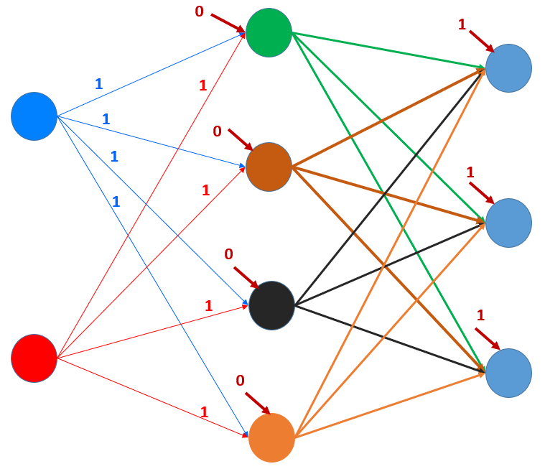
HIDDEN LAYER
OUTPUT LAYER
INPUT LAYER

Slide 20
Model et ses paramètres
from keras.models import Sequential
from keras.layers import Flatten, Dense, Activation
model = Sequential()
#input_layer=Flatten(input_shape=[2, 1])
#model.add(input_layer)
hidden_layer=Dense(4, input_dim=2,kernel_initializer='ones',bias_initializer='zeros')
model.add(hidden_layer)
output_layer=Dense(3, kernel_initializer='random_uniform',bias_initializer='ones')
model.add(output_layer)
print(model.summary())
print(model.get_weights()) #initial weights
[array([[1., 1., 1., 1.],[1., 1., 1., 1.]], dtype=float32),
array([0., 0., 0., 0.], dtype=float32),
array([[-0.03575971, -0.02119735, 0.01558626],
[ 0.04222678, -0.04578313, 0.0360521 ],
[-0.02753322, 0.00745941, -0.04211374],
[-0.04299896, -0.04190966, 0.02975568]], dtype=float32),
array([1., 1., 1.], dtype=float32)]
model.compile(loss="categorial_crossentropy",
optimizer="adam",
metrics=["accuracy"])

Slide 21
Revenons à
XOR Problem
X1
! AND
AND
y
OR
Les étapes à suivre pour créer le modèle
X2
Data
Model
Create the model, compile the model: keras, tensorflow
Optimizer function: adam
Loss function: binary_crossentropy
Train the model
Parameters
Prediction
Evaluation
0
1
0
1
-0.033
1
0
0.041
1

Slide 22
1. Dataset
X=np.array([[0,0],[0,1],[1,0],[1,1]])
y = np.array(np.logical_xor(X[:, 0] > 0, X[:, 1] > 0), dtype=int)

Slide 23
2. Model
from keras.models import Sequential
from keras.layers import Activation, Dense,Flatten
model = Sequential()
#input_layer = Flatten(input_shape=[2,1])
hidden_layer = Dense(2,input_dim=2, kernel_initializer='ones',bias_initializer='zeros’, activation=‘relu’)
output_layer = Dense(1,kernel_initializer='random_uniform',bias_initializer='zeros’, activation=‘sigmoid’)
#model.add(input_layer)
model.add(hidden_layer)
model.add(output_layer)
coef=model.get_weights()
print(coef)
0
1
0
1
-0.033
1
0
0.041
1
[array([[1., 1.], [1., 1.]], dtype=float32), array([0., 0.], dtype=float32),
array([[-0.03330588], [ 0.04190588]], dtype=float32), array([0.], dtype=float32)]
model.compile(loss='binary_crossentropy',optimizer='adam',metrics=['accuracy'])
model.fit(X,y,epochs=1000)
print(model.get_weights())
print(model.predict(X)

Slide 24
bias1
w11
bias3
w21
w31
w12
bias2
w32
w22

Slide 25
model.fit(X,y,epochs=1000)
print(model.get_weights())
print(model.predict(X)

Slide 26
2. Model (avec une autre fonction d’activation)
from keras.layers import LeakyReLU
act = LeakyReLU(alpha = 0.3)
model = Sequential()
hidden_layer = Dense(2,input_dim=2, kernel_initializer='ones',bias_initializer='zeros',activation=act)
model.add(hidden_layer)
output_layer = Dense(1,kernel_initializer='random_uniform',bias_initializer='zeros',activation='sigmoid')
model.add(output_layer)
model.add(hidden_layer)
model.add(output_layer)
coef=model.get_weights()
print(coef)
model.compile(loss='binary_crossentropy',optimizer='adam',metrics=['accuracy'])

Slide 27
model.fit(X,y,epochs=1000,batch_size=4)
print(model.get_weights())
print(model.predict(X))

